Slide 1
Machine learning on water potability dataset
Anusha Kulkarni - 002832115
Panchami Baleri - 002820639

Slide 2
The machine learning models we chose and why
Gaussian Naïve Bayes
Random Forest
K-Nearest Neighbors
Decision Tree

Slide 3
Why water quality dataset ?
Access to safe and readily available water is crucial for public health.
Improved water supply, sanitation, and effective water resource management contribute to economic growth and poverty reduction
Contaminated water and poor sanitation are linked to the transmission of diseases like cholera, diarrhea, dysentery, hepatitis A, typhoid, and polio.
Inadequate water and sanitation services expose individuals to preventable health risks, particularly in healthcare facilities.
Motivated by these considerations, we aim to utilize a Water Quality dataset to delve into what defines safe and potable water
Employing machine learning techniques, we aspire to differentiate between Potable and Non-Potable water, contributing to the understanding and identification of water quality characteristics that ensure its safety for various purposes.

Slide 4
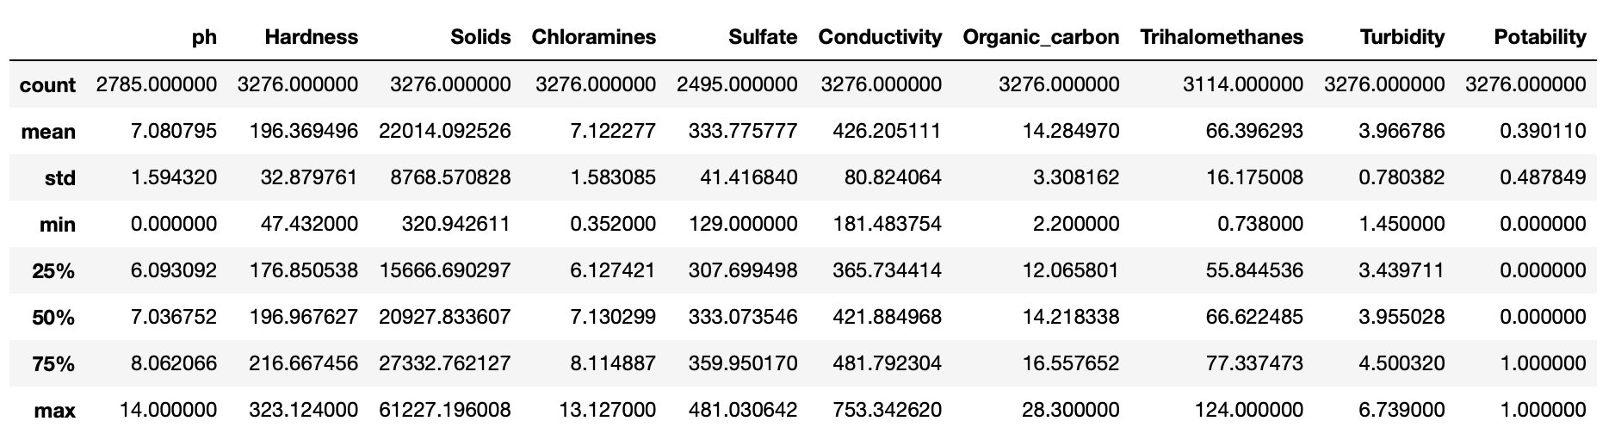
DATASET DESCRIPTION
Shape: 3276 rows and 10 columns
All columns are of numerical value
No duplicate values
The features ph, sulfate, trihalomethanes have null values

Slide 5
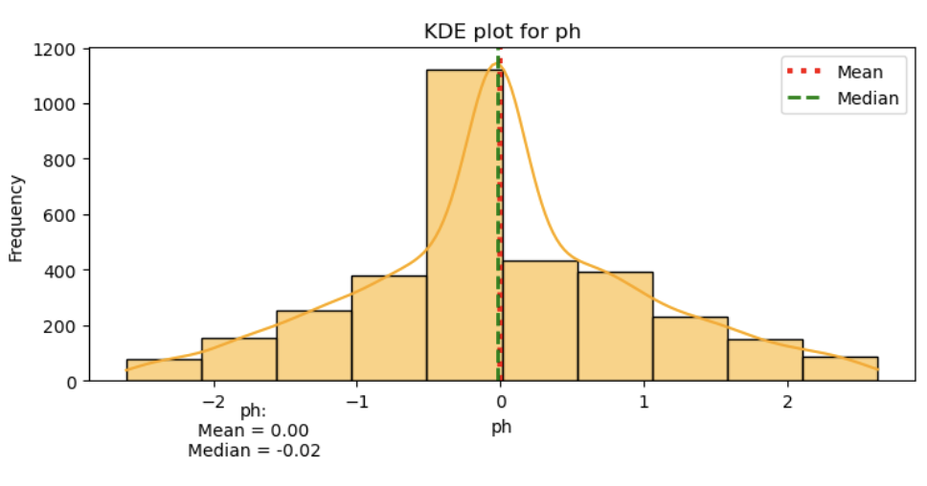
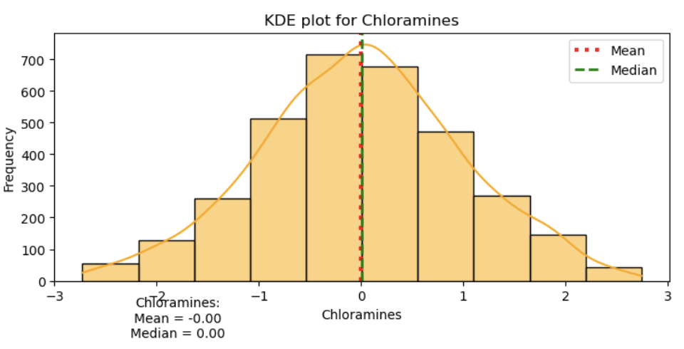
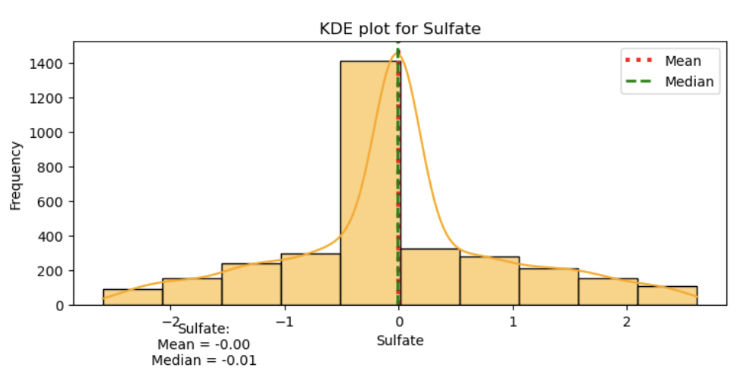
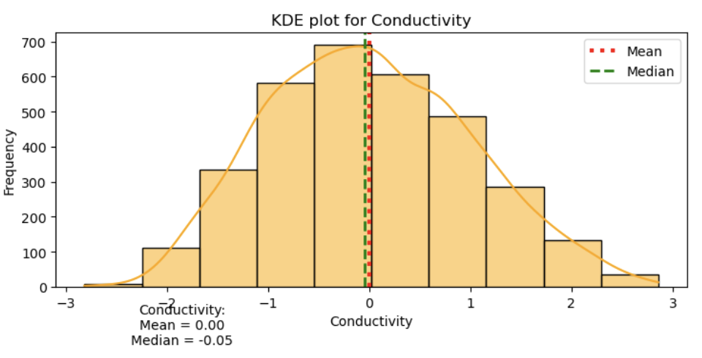
Exploratory data analysis
KDE PLOTS

Slide 6
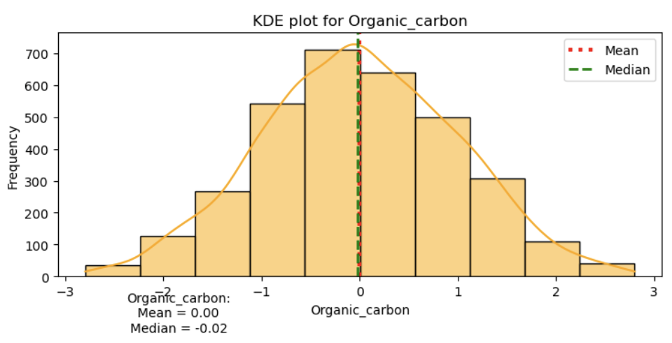
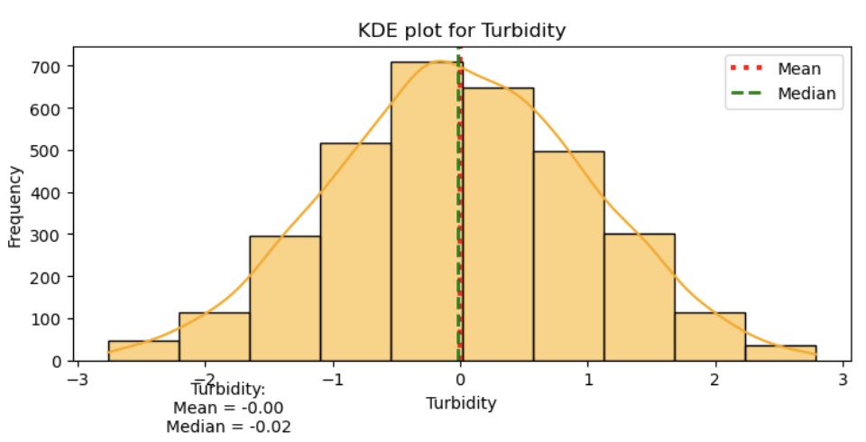

Slide 7
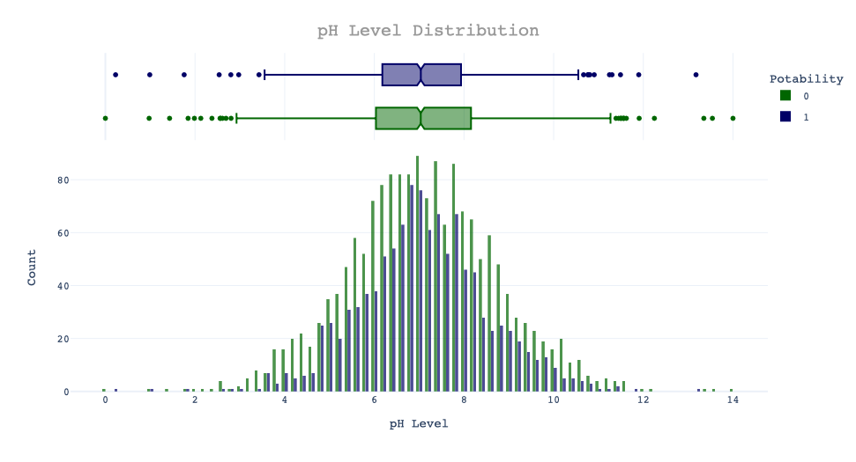
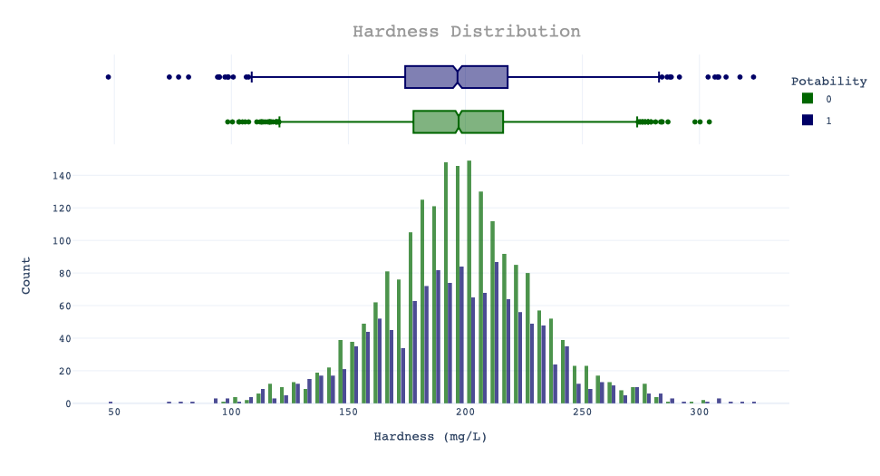
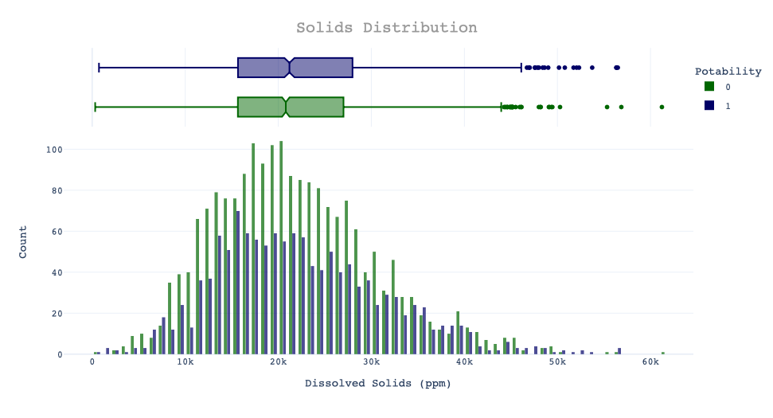
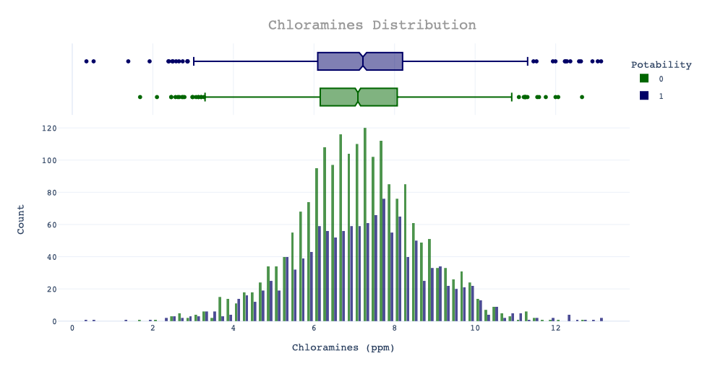
HISTOGRAM analysis

Slide 8
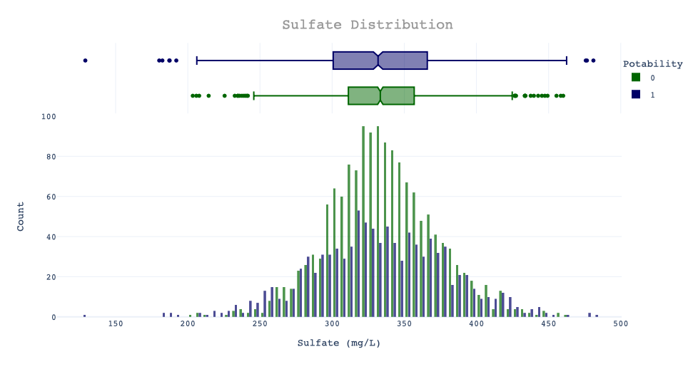
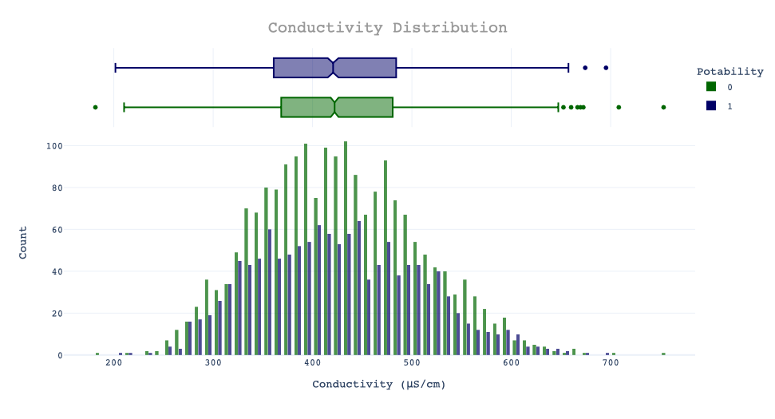
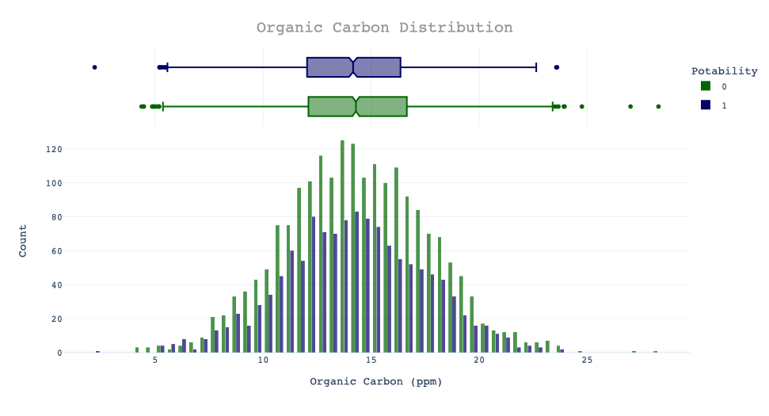
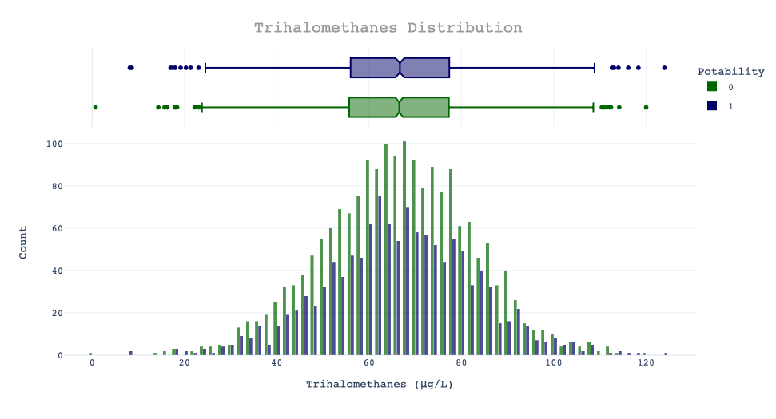
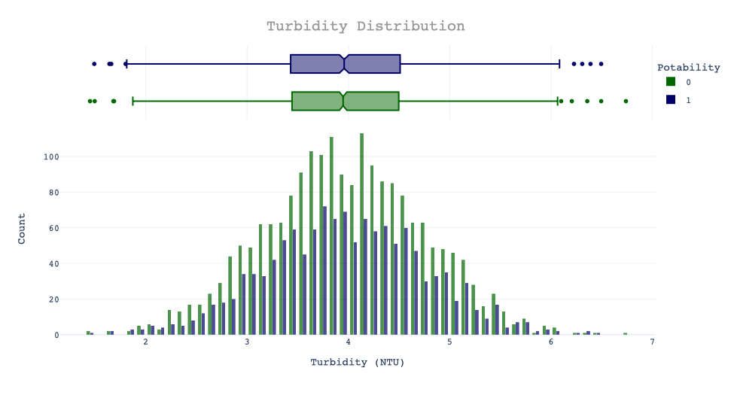

Slide 9
WHAT HAVE WE LEARNT FROM THE ANALYSIS?

Slide 10
CONCLUSION

Slide 11
FUTURE IMPROVEMENT

Slide 12
REFERENCES
jaykumar1607. Water Quality Analysis: Plotly and Modelling. Kaggle. https://www.kaggle.com/code/jaykumar1607/water-quality-analysis-plotly-and-modelling
Analytics Vidhya. (2022, March). Gaussian Naive Bayes Algorithm for Credit Risk Modelling. Analytics Vidhya. https://www.analyticsvidhya.com/blog/2022/03/gaussian-naive-bayes-algorithm-for-credit-risk-modelling/

Slide 13
Thank you!

